Slide 1

Implementing Comprehensive Blockchain Based Framework for Transparent Real Estate Transactions
Group No. 1
Amit Pandey 18104020
Aditya Shinde 18104032
Rajan Khade 18104020
Project Guide
Prof. Neha Deshmukh
Notes:
‹#›

Slide 2
Contents
Introduction
Objectives
Problem Definition
Technological Stack
Review Suggestions
Proposed System Architecture/Working
Implementation Status
Notes:
‹#›

Slide 3
Introduction
Problem Identified :
The Involvement of middlemen and brokers.
The increasing number of fraud cases.
Time delays and lack of digital protection.
Solution Proposed :
Blockchain based platform using Hyperledger Fabric.
Permissioned access to the system and infrastructure.
Real estate transaction using web application.
Digital record keeping of all the transactions in a Ledger.

Slide 4
Objectives
To make process faster and bring transparency with the use of blockchain.
To Reduce the fraud cases.
To make the process of real estate transactions digital.

Slide 5
Technological Stack
Blockchain
Technology - Hyperledger Fabric
Chaincode - Go
Web Application
Backend – Node.js, Express.js
Frontend - HTML, CSS, JavaScript
Database (session storage) - MongoDB

Slide 6
Review Suggestions
To add a Government Entity in the process.
To use Hyperledger Fabric technology.

Slide 7
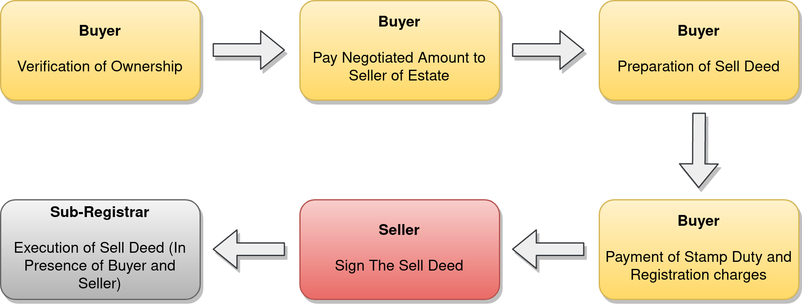
Existing System

Slide 8
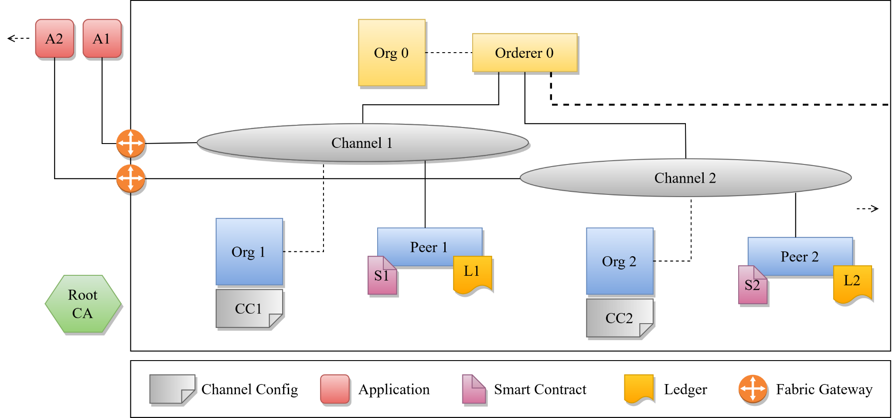
Proposed Hyperledger Fabric Architecture
Org 0 | Central Govt.
Root CA | Central Govt.
Org 1 | State 1 Govt.
Org 2 | State 2 Govt.

Slide 9
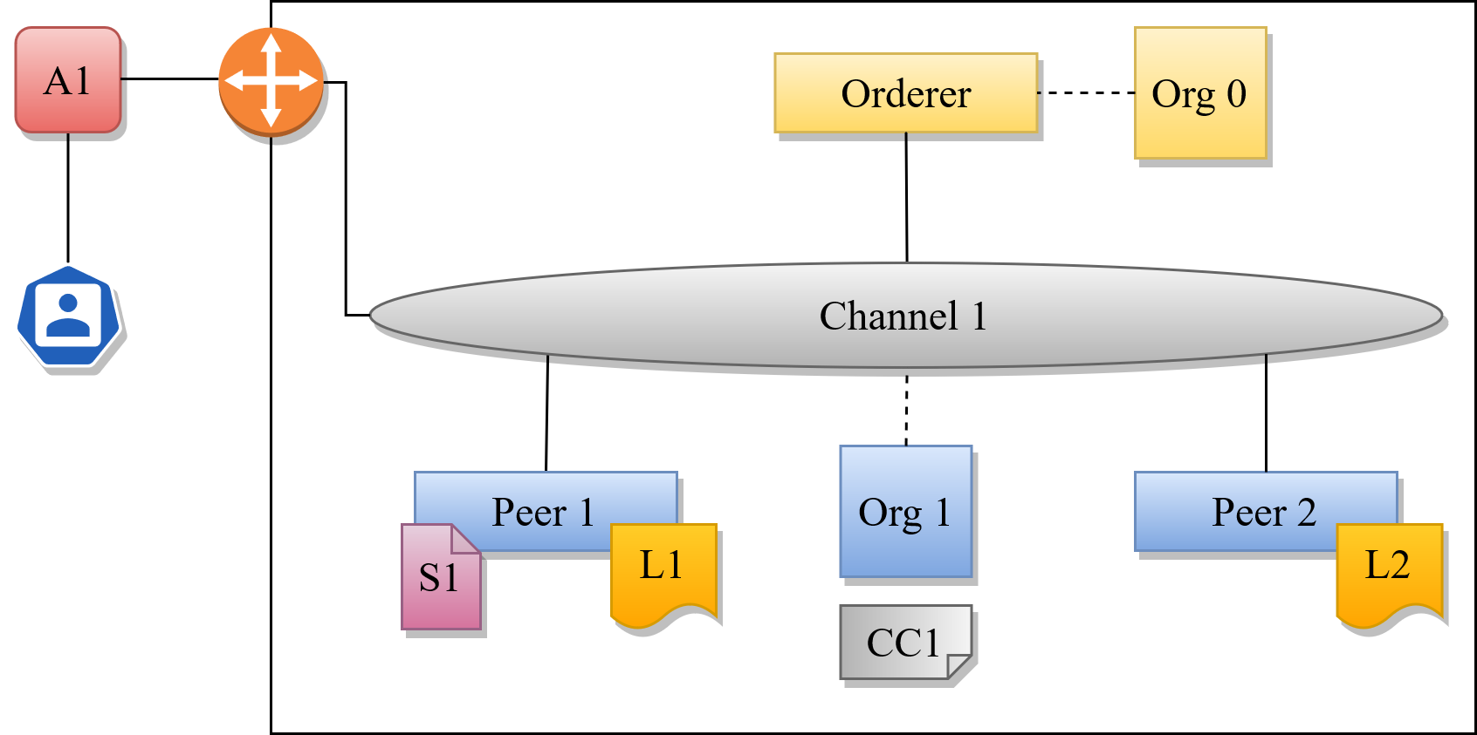

Slide 10
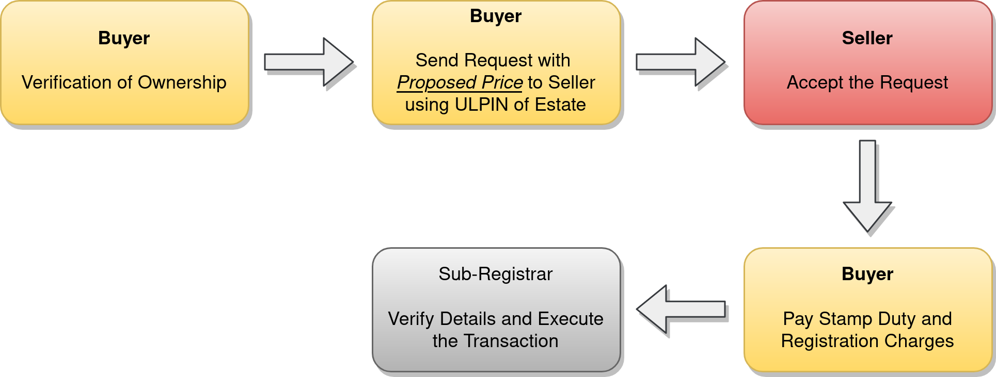
Proposed System Architecture

Slide 11
Implementation Status
Hyperledger Fabric Setup is done.
Chaincode (Smart Contract) development is done.
Web Application (both frontend and backend) development is done.
Chaincode need a security audit and testing.

Slide 12
Thank You...!!
Notes:
‹#›

